Slide 1
Lattice optimisation for Trainer midsole
Parametric comparison of three TPU lattice geometries under an 80 kg runner heel-strike load (2,000 N) to maximise Specific Energy Absorption (SEA) while reducing weight.

Slide 2
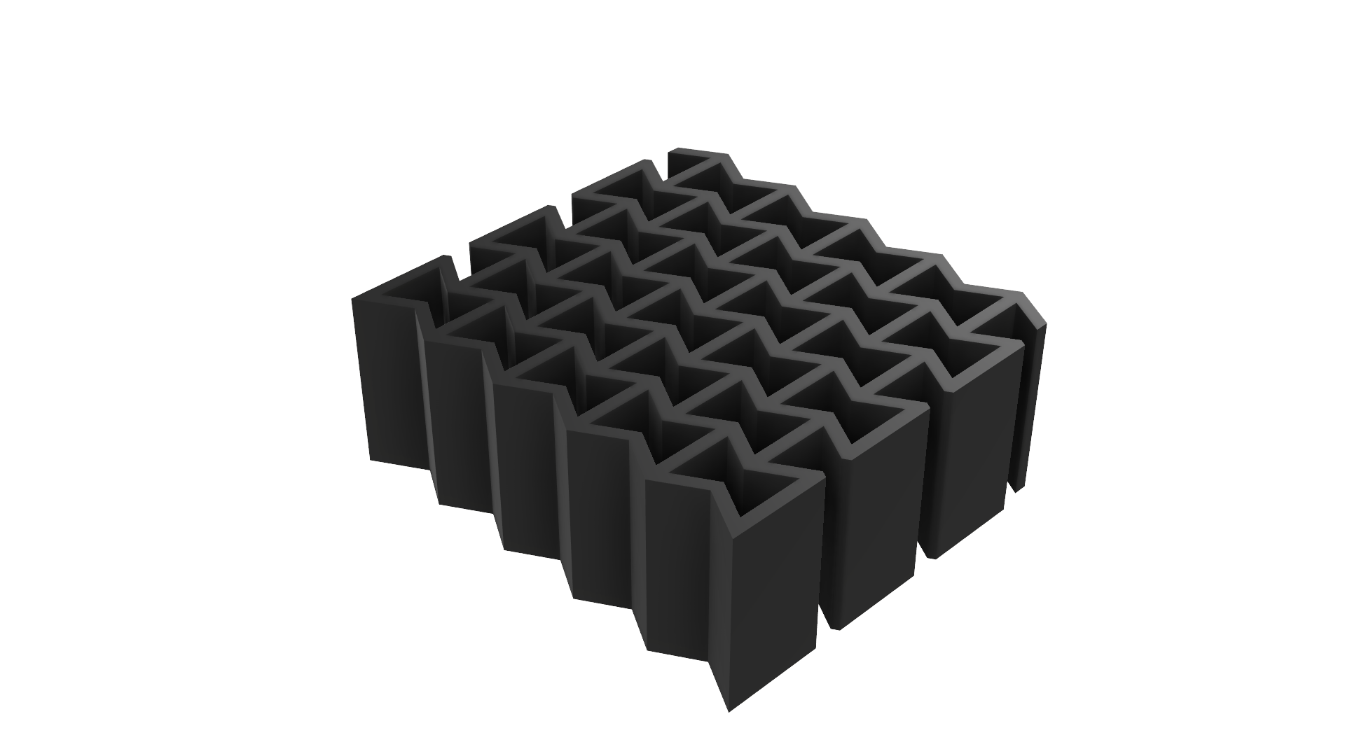
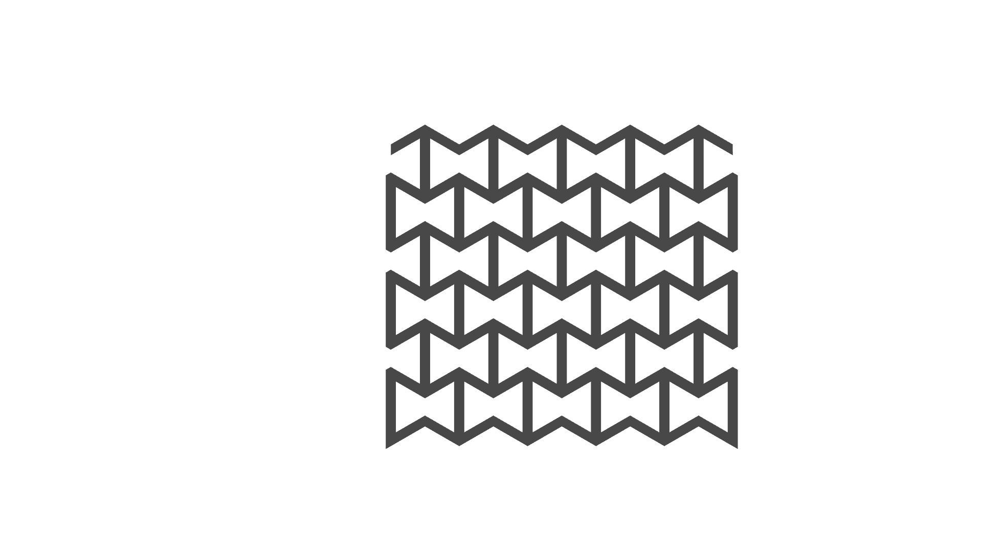
Re-entrant Auxetic
Isometric
Top

Slide 3
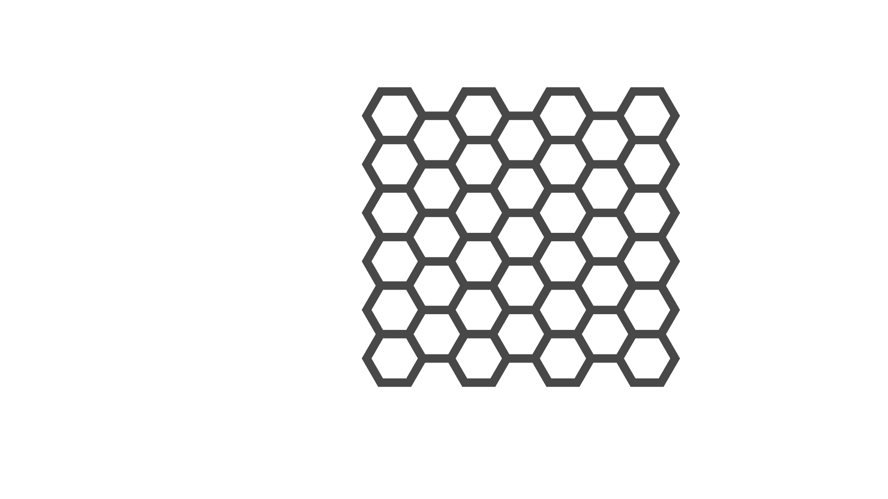
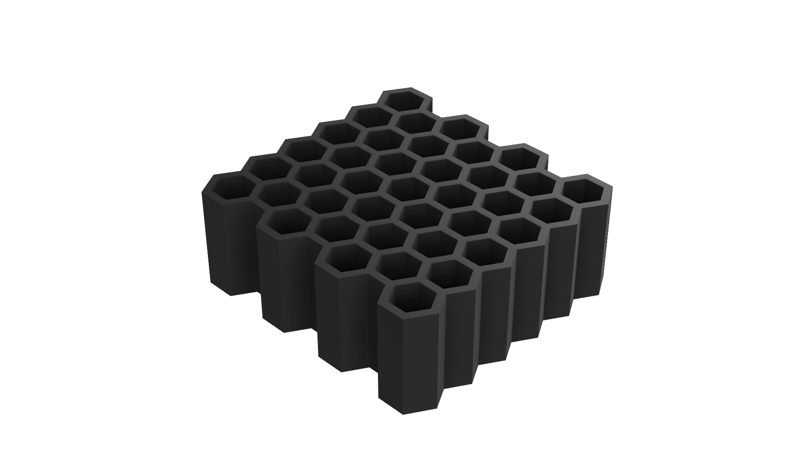
Honeycomb
Isometric
Top

Slide 4
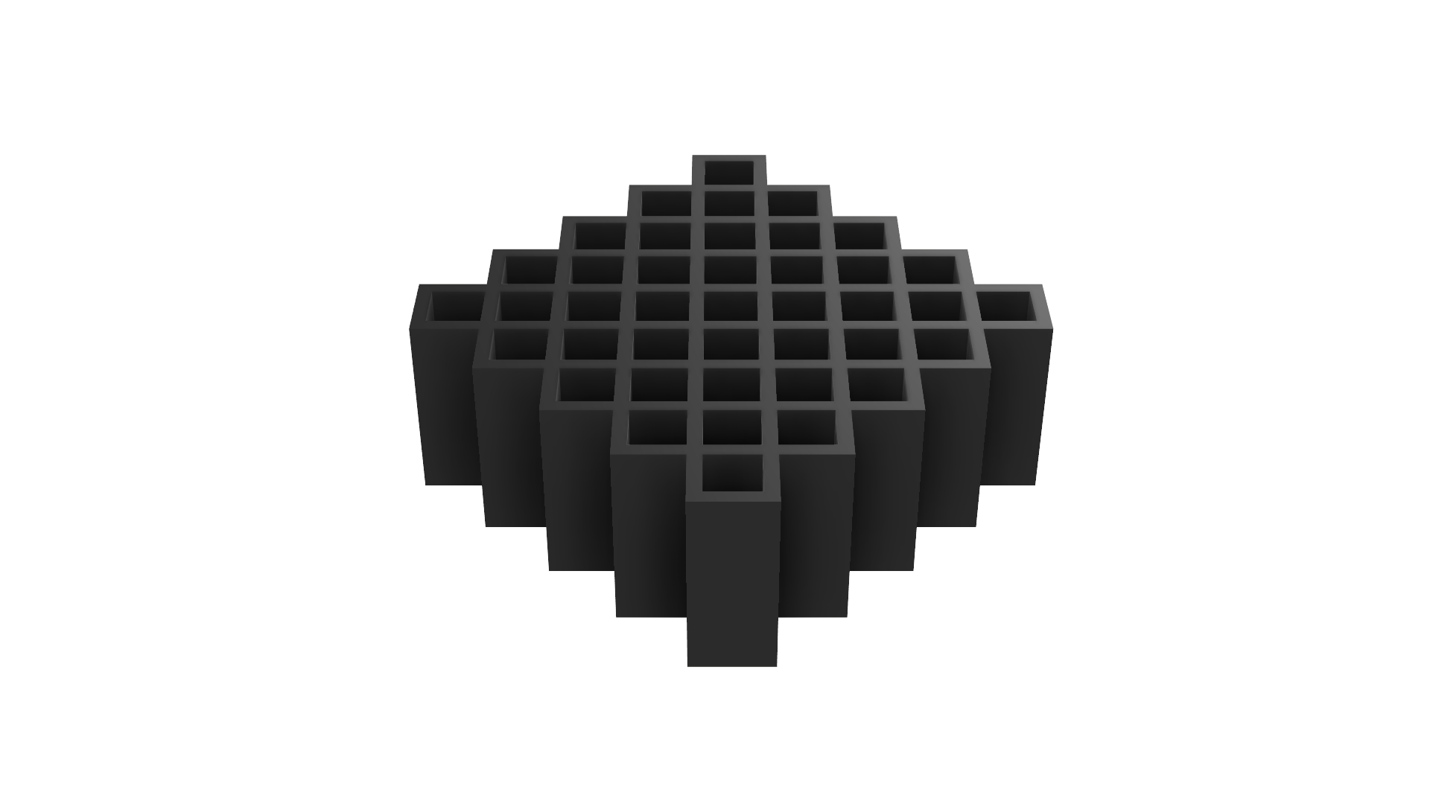
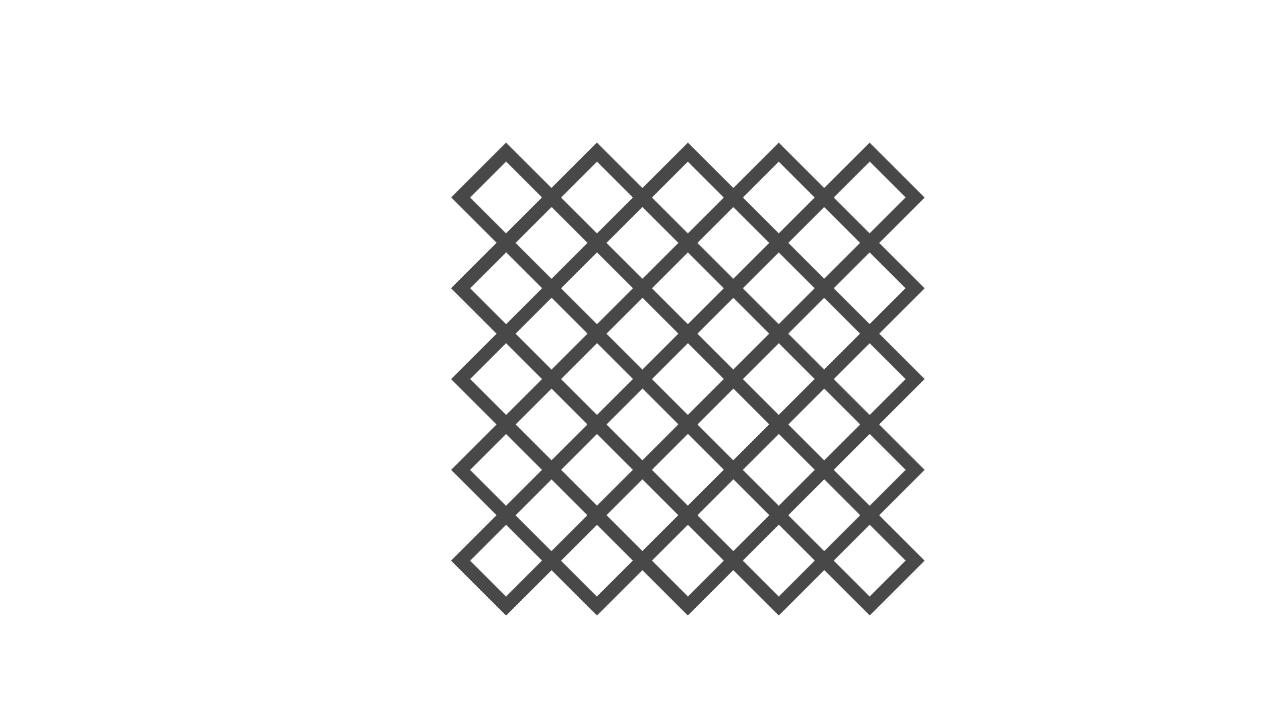
Diamond
Isometric
Top

Slide 5
Property | Solid TPU Block (Baseline) | Re-entrant Auxetic (bowtie) | Hexagonal Honeycomb | Diamond
Bounding Box (mm) | 50 x 50 x 20 | 47.5 x 51.5 x 20 | 55.71 x 52.5 x 20 | 52.12 x 52.12 x 20
Bounding box solid mass (g) | 60.00 | 61.8 | 60.00 | 65.20
Volume (V) (mm^3) | 50,000.00 | 19,972.08 | 19,424.95 | 19,413.20
Surface area (mm^2) | 9,000.00 | 26,575.51 | 25,867.89 | 25,425.59
Steel Mass (fusion 360) g | 392.50 | 156.78 | 152.49 | 152.39
Equivalent TPU mass g | 60.00 | 23.97 | 23.31 | 23.30
Relative density | 1.000 | 0.388 | 0.388 | 0.357
Mass reduction vs bounding box % | 0.0 | 61.2 | 61.2 | 64.3
Mass reduction vs 60g standard block % | 0.0 | 60.1 | 61.2 | 61.2

Slide 6
Mesh convergence
Constraints: bottom face fixed, top face experiences 2000N load, simulating peak heel-strike force experienced by an 80 kg runner
Static stress analysis done for 3mm,1.5mm and 1mm mesh
Mesh size, mm | Peak Von Mises Stress, MPa | Percentage Increase, % | Resolution and study status
3 | 2.818 | N/A | Under-resolved (oversmoothed corners)
1.5 | 3.821 | 35.59 | Optimal balance of solution speed and accuracy
1 | 4.584 | 19.97 | High refinement (approaching re-entrant corner singularity
Selecting 1.5 mm element size across all three geometry variants resolves nominal wall bending and overall structural displacement
Done on the bowtie shape
The sharp, un-filleted internal re-entrant corners introduce a theoretical stress singularity in linear static FEA. As mesh element size gets smaller, peak stress at sharp internal corners continues to climb rather than fully converging
Adding a small fillet (R0.5mm) to areas of high localised stresses in future CAD iterations would mitigate this singularity, distribute stress smoothly, and reduce physical fatigue failure during dynamic impact.

Slide 7
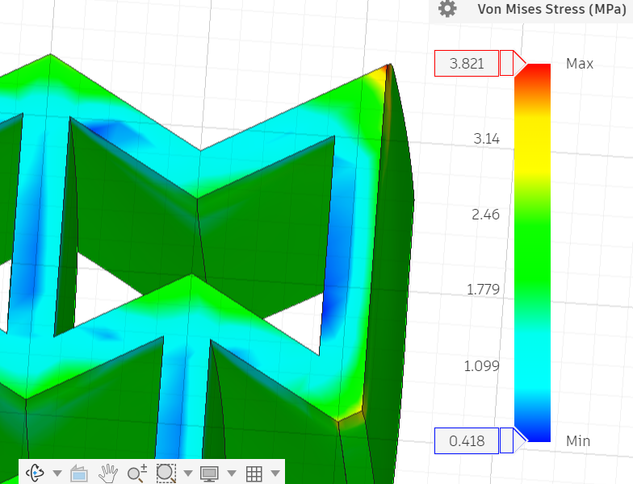
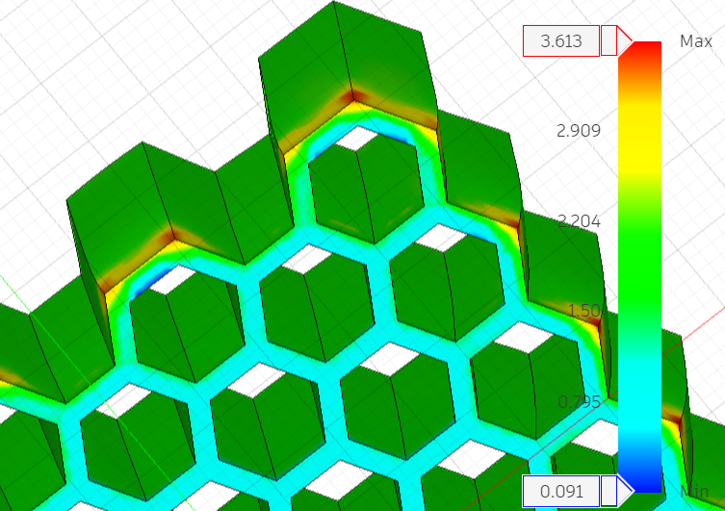
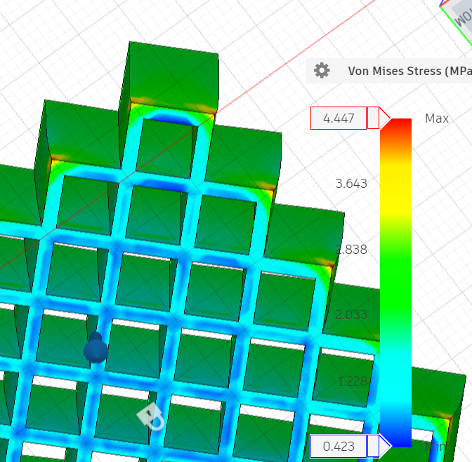
Max Von Mises stress
Using 1.5 mm mesh
Design | Max Von Mises Stress (MPa) | Key areas of high stress concentrations
Re-entrant Auxetic | 3.821 | All corners (including internal) especially on the outer corners (replicating the outsides of the insoles) Smooth corners to overcome. Of course, stress where the load is applied but highest is as mentioned above
Honeycomb | 3.613 | Similar as above but only outer corners were experiencing the greater stress, rather than all of the internal ones (on the fixed surface) ( was still less stress than above)
Diamond | 4.447 | Similar as above but a lot more areas of significantly low stress on the bottom

Slide 8
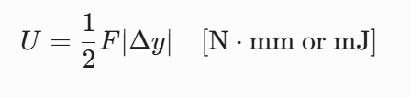
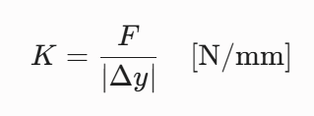
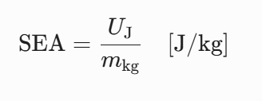
Calculations
Design | Displacement (in direction of force) mm | Stiffness (K, N/mm) | Strain Energy (U, J) | Specific Energy Absorption (J/kg)
Re-entrant Auxetic | −1.412 | 1416.43 | 1.412 | 58.91
Honeycomb | −1.473 | 1,357.77 | 1.473 | 63.19
Squares | -1.458 | 1,371.74 | 1.458 | 62.58
The Re-entrant Auxetic structure provides the highest stiffness / lowest compliance but achieves roughly 6% lower Specific Energy Absorption (58.91 J/kg) than the other designs.
Honeycomb provides the lowest stiffness/highest compliance and achieves the highest Specific Energy Absorption at 63.19 J/kg).

Slide 9
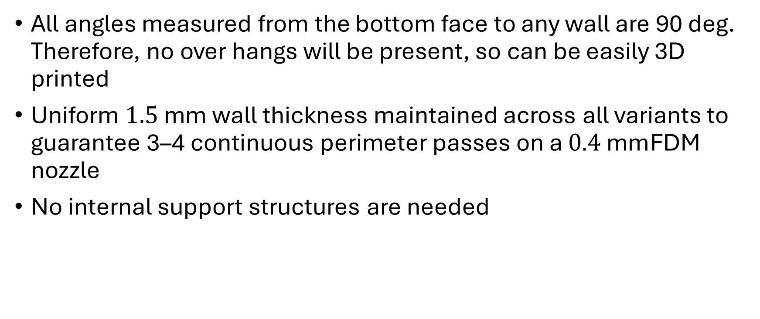
Design for Additive Manufacturing Validation
All angles measured from the bottom face to any wall are 90 deg. Therefore, no over hangs will be present, so can be easily 3D printed
Uniform $1.5\text{ mm}$ wall thickness maintained across all variants to guarantee 3–4 continuous perimeter passes on a $0.4\text{ mm}$FDM nozzle
No internal support structures are needed
Shape | Print time(h:m:s) | Mass of Filament used (g) (density of 1.25
Re-entrant Auxetic | 04:45:18 | 26.05
Honeycomb | 05:00:26 | 25.73
Squares | 04:49:22 | 25.75
https://grid.space/kiri/

Slide 10
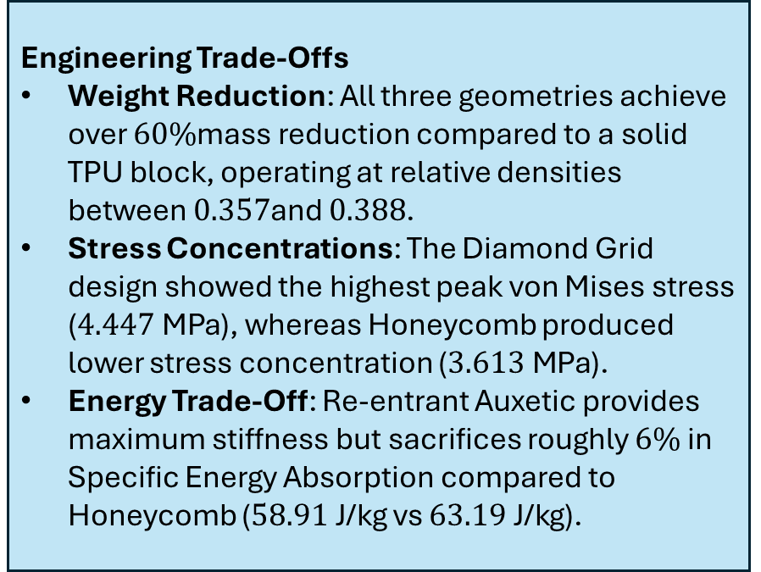
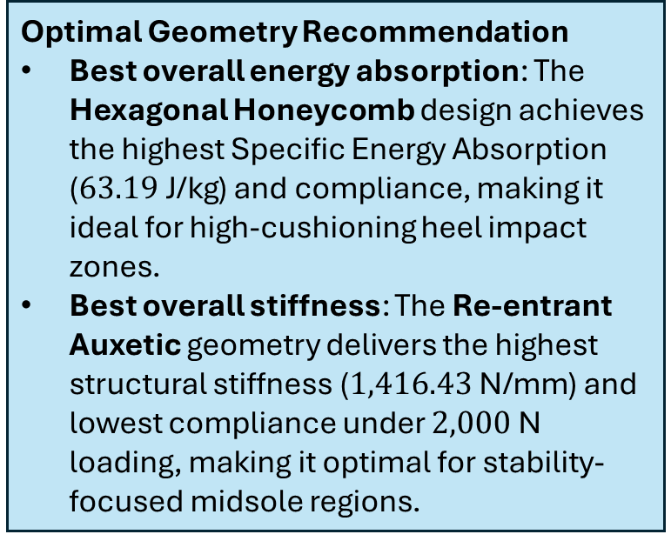
Conclusions
Optimal Geometry Recommendation
Best overall energy absorption: The Hexagonal Honeycomb design achieves the highest Specific Energy Absorption ($63.19\text{ J/kg}$) and compliance, making it ideal for high-cushioning heel impact zones.
Best overall stiffness: The Re-entrant Auxetic geometry delivers the highest structural stiffness ($1,416.43\text{ N/mm}$) and lowest compliance under $2,000\text{ N}$ loading, making it optimal for stability-focused midsole regions.
Engineering Trade-Offs
Weight Reduction: All three geometries achieve over $60\%$mass reduction compared to a solid TPU block, operating at relative densities between $0.357$and $0.388$.
Stress Concentrations: The Diamond Grid design showed the highest peak von Mises stress ($4.447\text{ MPa}$), whereas Honeycomb produced lower stress concentration ($3.613\text{ MPa}$).
Energy Trade-Off: Re-entrant Auxetic provides maximum stiffness but sacrifices roughly $6\%$ in Specific Energy Absorption compared to Honeycomb ($58.91\text{ J/kg}$ vs $63.19\text{ J/kg}$).

Slide 11
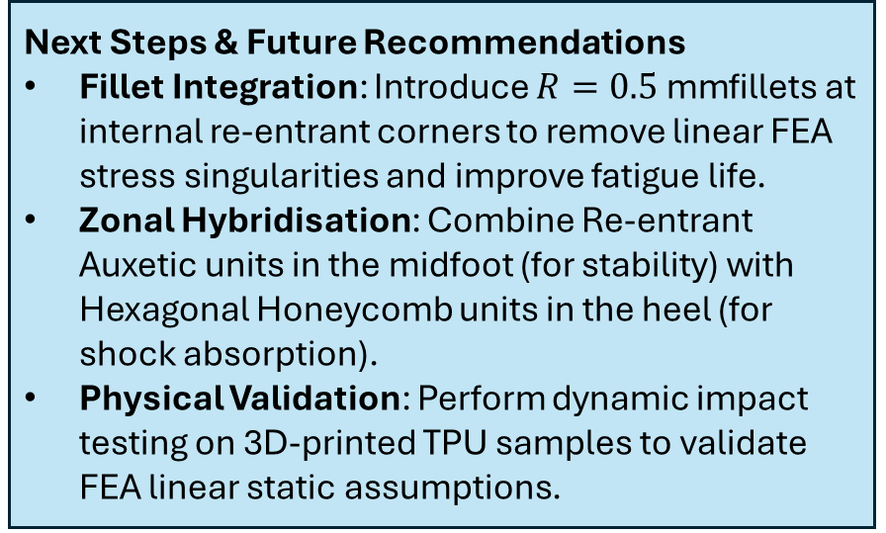
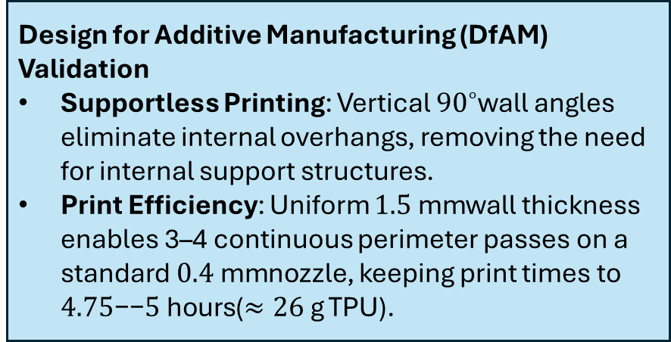
Conclusions
Design for Additive Manufacturing (DfAM) Validation
Supportless Printing: Vertical ${90}^{∘}$wall angles eliminate internal overhangs, removing the need for internal support structures.
Print Efficiency: Uniform $1.5\text{ mm}$wall thickness enables 3–4 continuous perimeter passes on a standard $0.4\text{ mm}$nozzle, keeping print times to $4.75\text{−−}5\text{ hours}$($≈26\text{ g}$ TPU).
Next Steps & Future Recommendations
Fillet Integration: Introduce $R=0.5\text{ mm}$fillets at internal re-entrant corners to remove linear FEA stress singularities and improve fatigue life.
Zonal Hybridisation: Combine Re-entrant Auxetic units in the midfoot (for stability) with Hexagonal Honeycomb units in the heel (for shock absorption).
Physical Validation: Perform dynamic impact testing on 3D-printed TPU samples to validate FEA linear static assumptions.

